Slide 1


Slide 2

Audio Cloud

Slide 3
Group Members Introduction
S19020E3FC
1. Mubashir Iqbal BC140400342
2. Arslan Maqbool BS140401325

Slide 4

INTRODUCTION OF PROJECT
The aim of this project is to develop a website named as audio cloud. Basic purpose of this project is to provide a platform for people to perform following activities as:
Users can upload, download and share their audio files of different categories to other people.
Users can share audio files from this platform to social media like Facebook, Twitter, WhatsApp, etc.
Users will be able to search, play audio file online, like/dislike, share and download all public audio files.
Users can create and manage their playlists of their favorite audio files. So that, they can play their playlist in future.

Slide 5
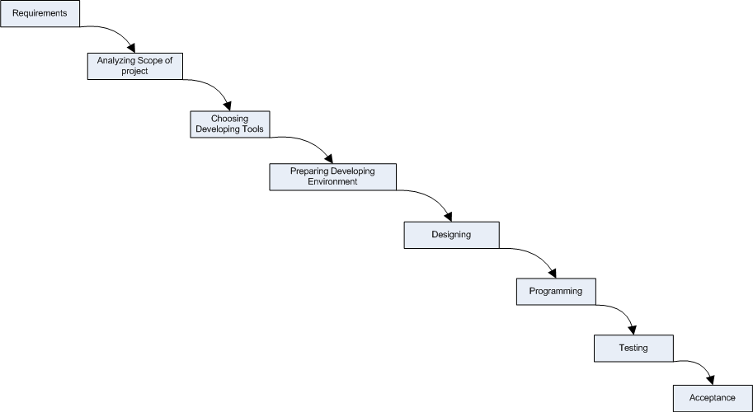
Process Diagram

Slide 6
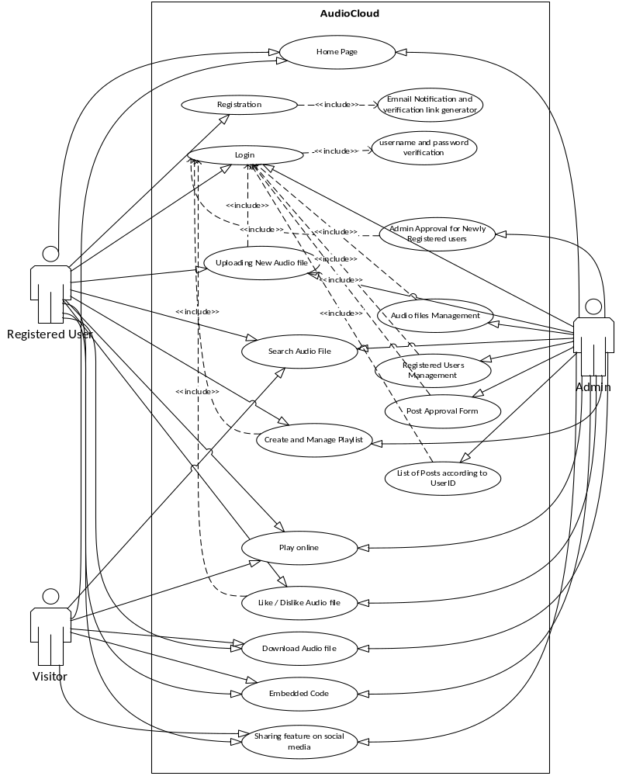
Use Case Diagram

Slide 7
Business Rules Catalog
Functional Requirements:
Following are the functional requirements of this project
User Registration
Email Verification link generator
Email Verification
Login
Admin Approval of uploading permission of newly registered user
Uploading audio files as public/private
Online audio player
Create and manage playlist
Search audio files
Like or dislike of audio file
Listen counts
Duration of audio file
Embedded code
Sharing feature on social media

Slide 8
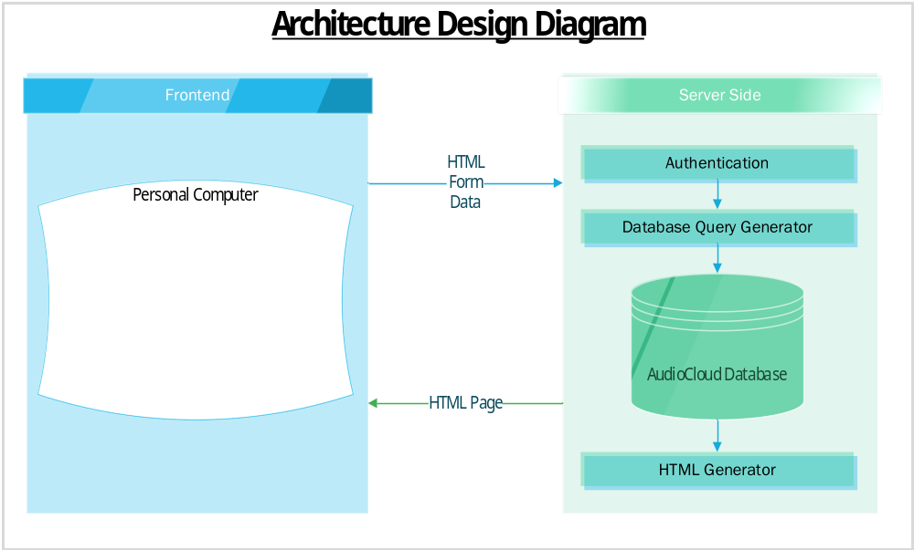
Architectural Design

Slide 9
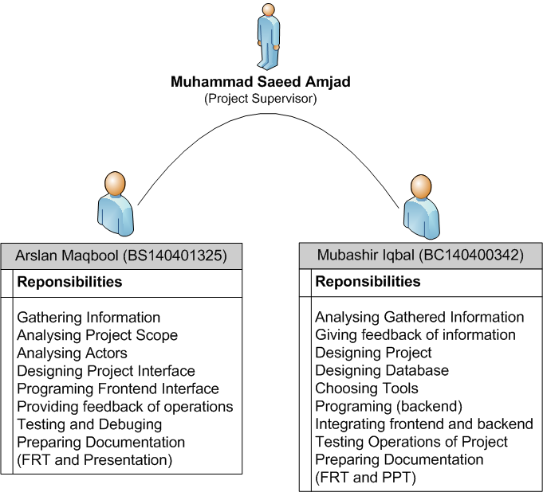
Team Structure

Slide 10
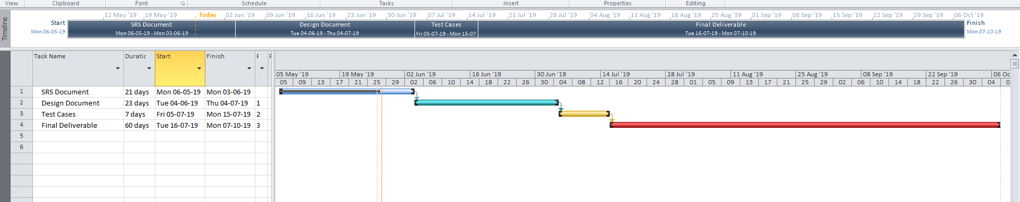
Project Schedule

Slide 11
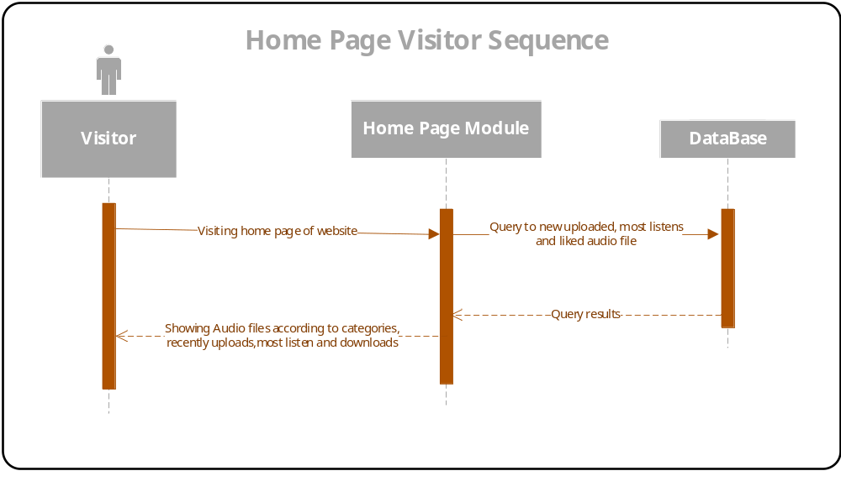
Sequence Diagrams

Slide 12
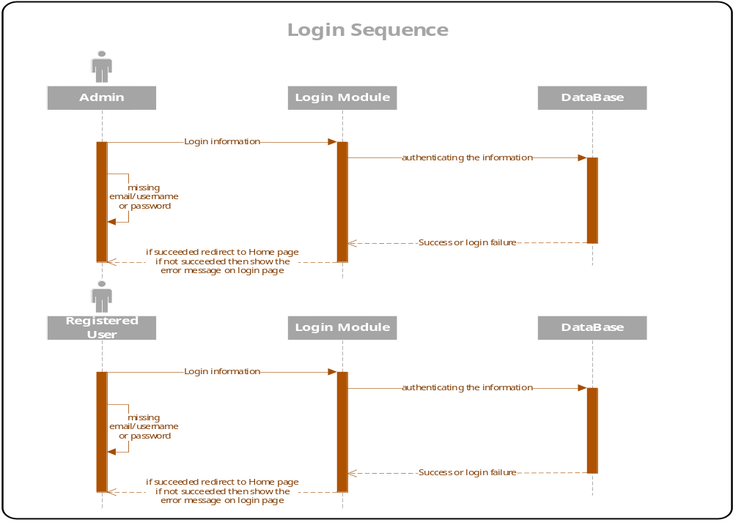

Slide 13
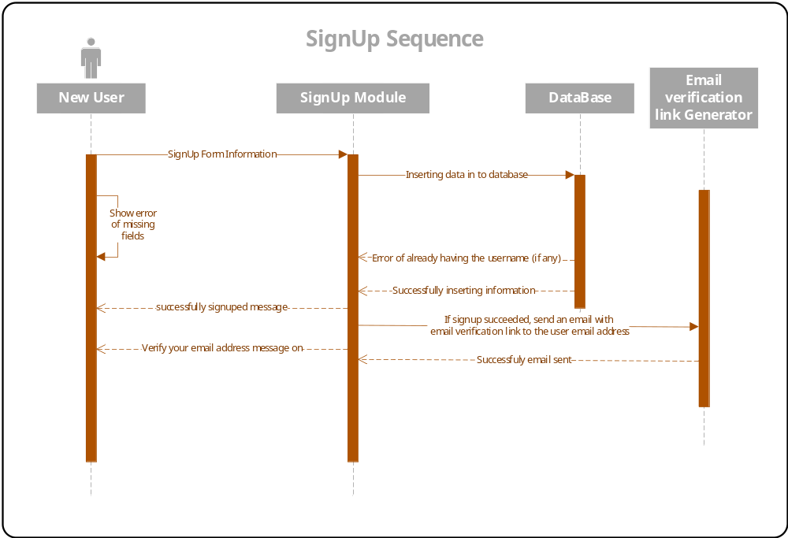

Slide 14
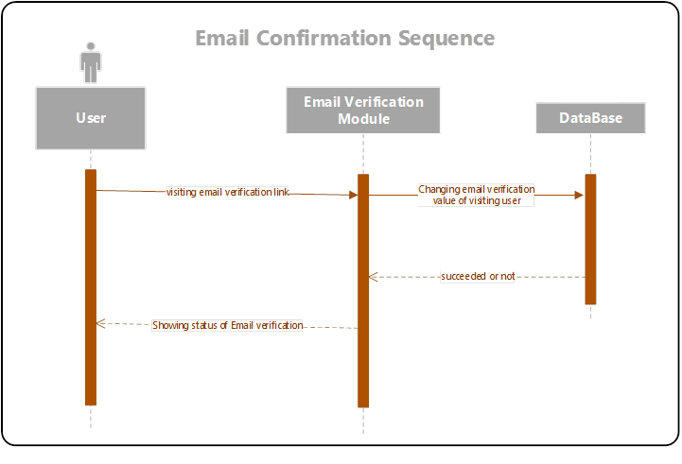

Slide 15
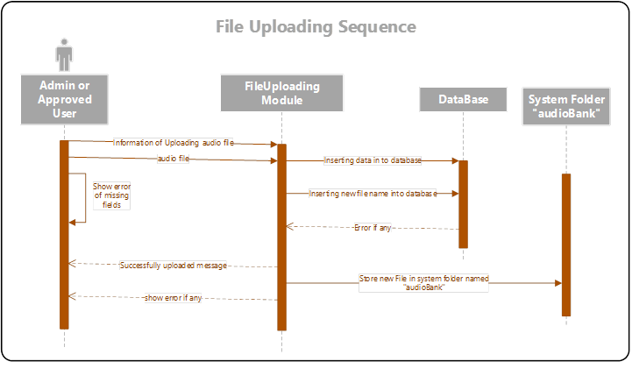

Slide 16
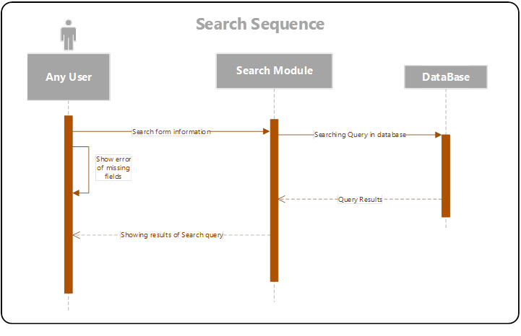

Slide 17
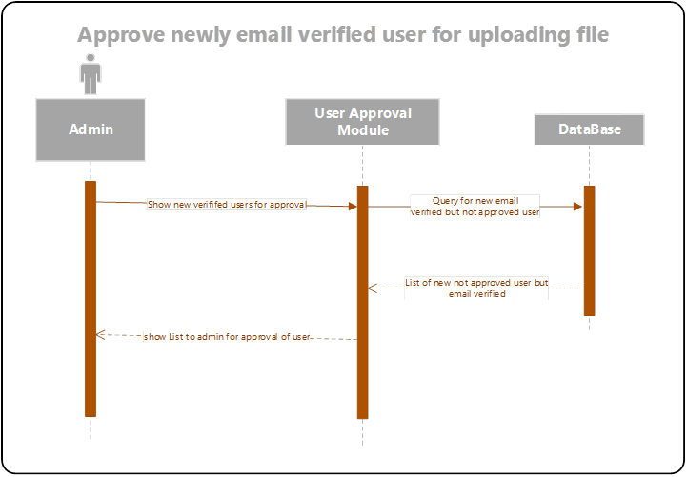

Slide 18
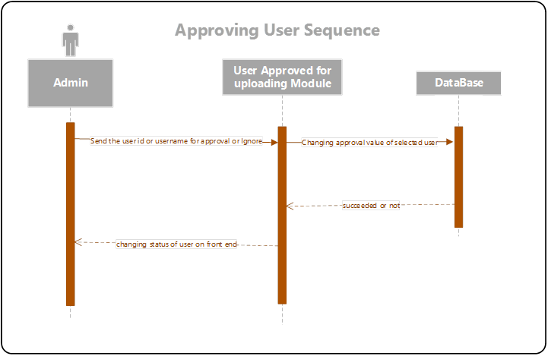

Slide 19
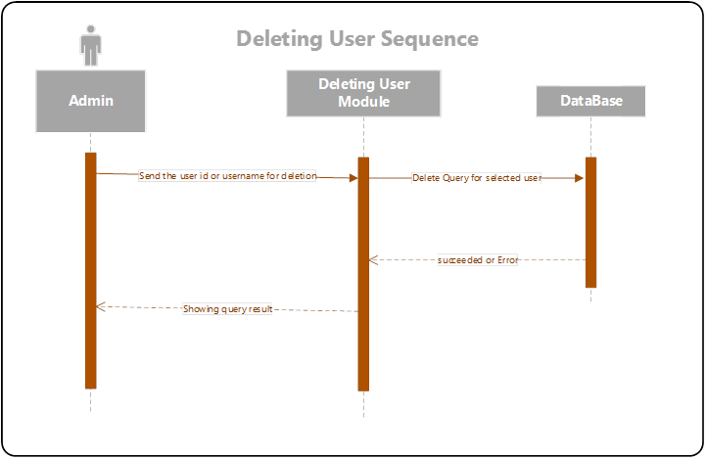

Slide 20
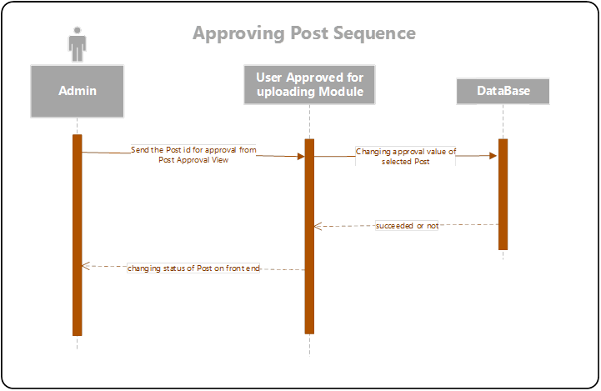

Slide 21
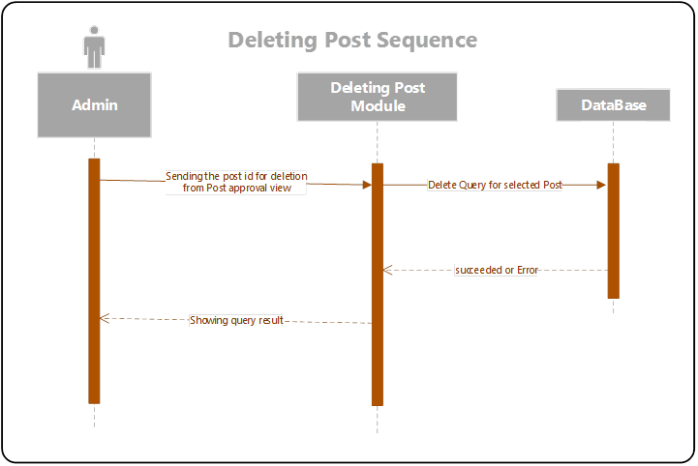

Slide 22
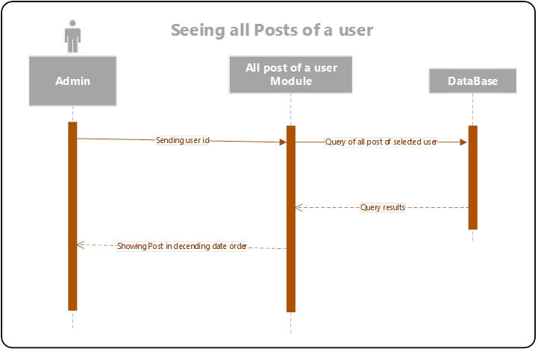

Slide 23
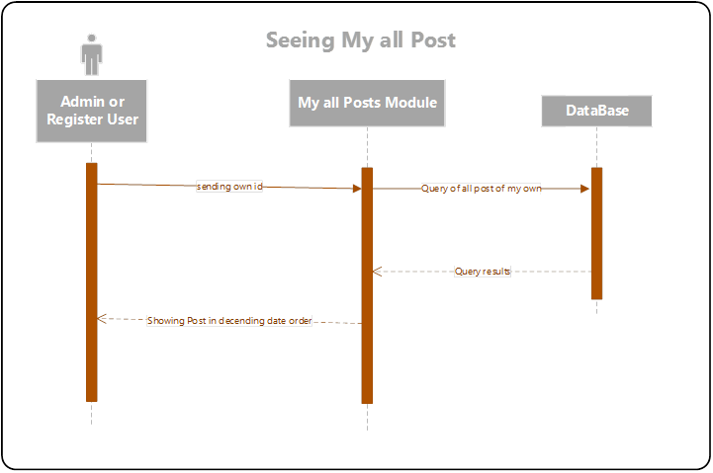

Slide 24
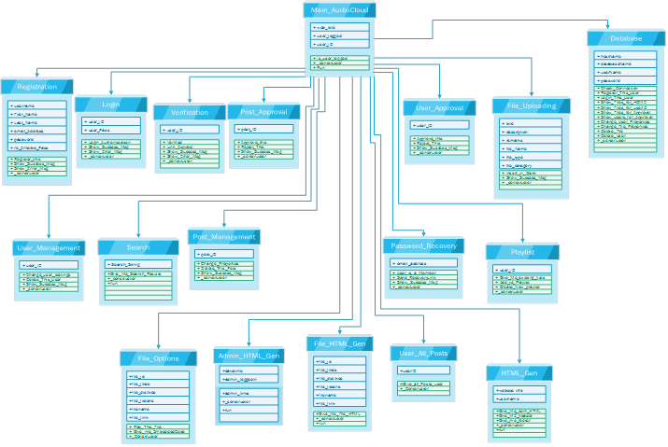
Logical Model/Class Diagram

Slide 25
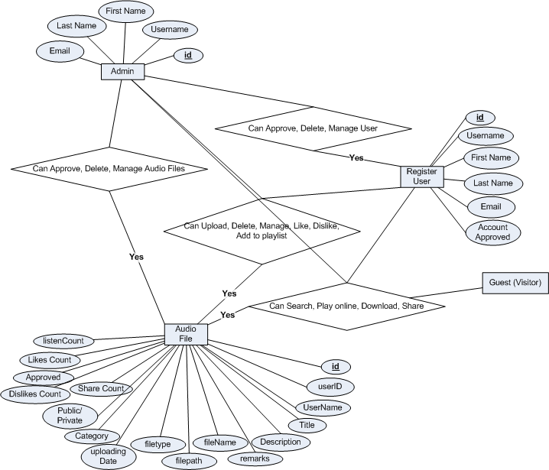
Entity-Relationship Diagram

Slide 26
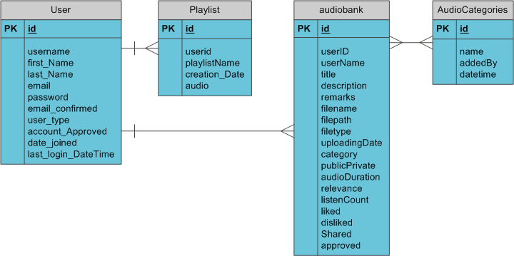
Database Diagram

Slide 27
User Interfaces
S/N | Interface Name | S/N | Interface Name
1 | Home Page | 2 | Registration Page
3 | Login Page | 4 | Search Home Page
5 | Search by Date Results Page | 6 | Search by Title Results page
7 | Search by Category Result Page | 8 | User Profile Page
9 | User Home Page | 10 | User Uploading New File
11 | User Playlists Page | 12 | My All Uploads Page
13 | Admin Home Page | 14 | Post Approval Page
15 | User Approval Page | 16 | Post Management Page
17 | User Management Page | 18 | Adding, Deleting Category Page
19 | Search All Posts by UserID Page

Slide 28
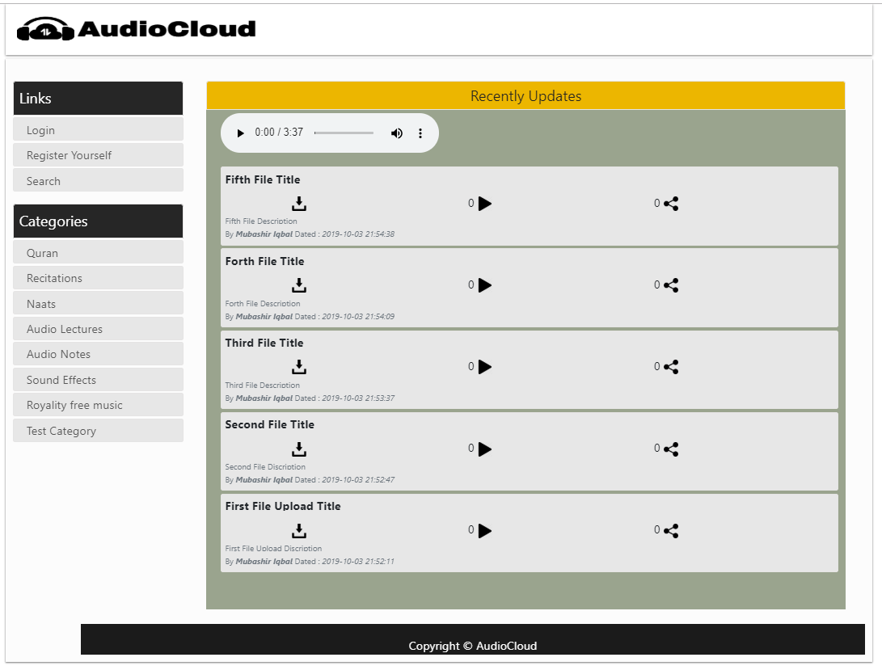
Home Page

Slide 29
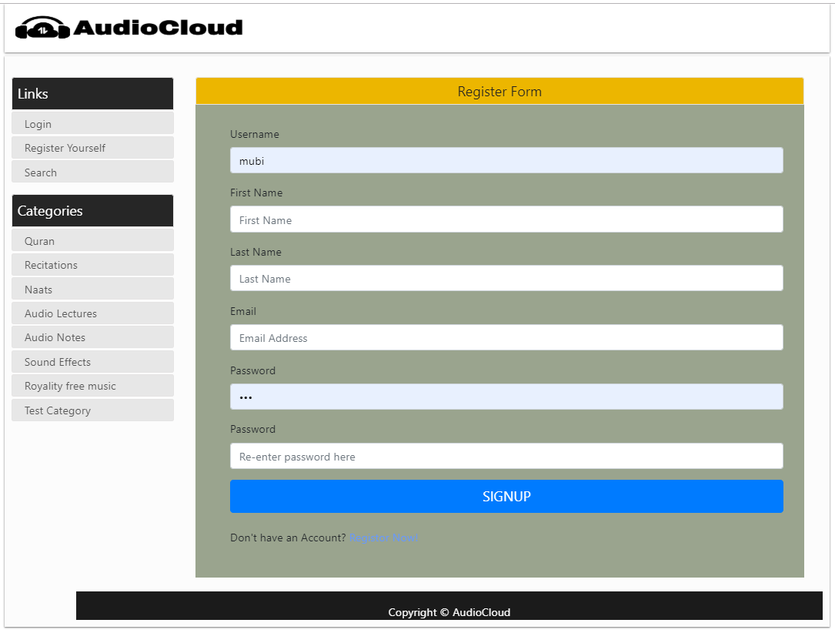
Registration Page

Slide 30
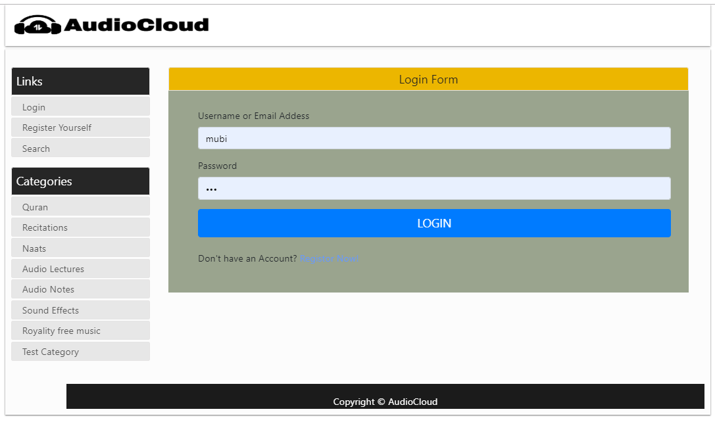
Login Page

Slide 31
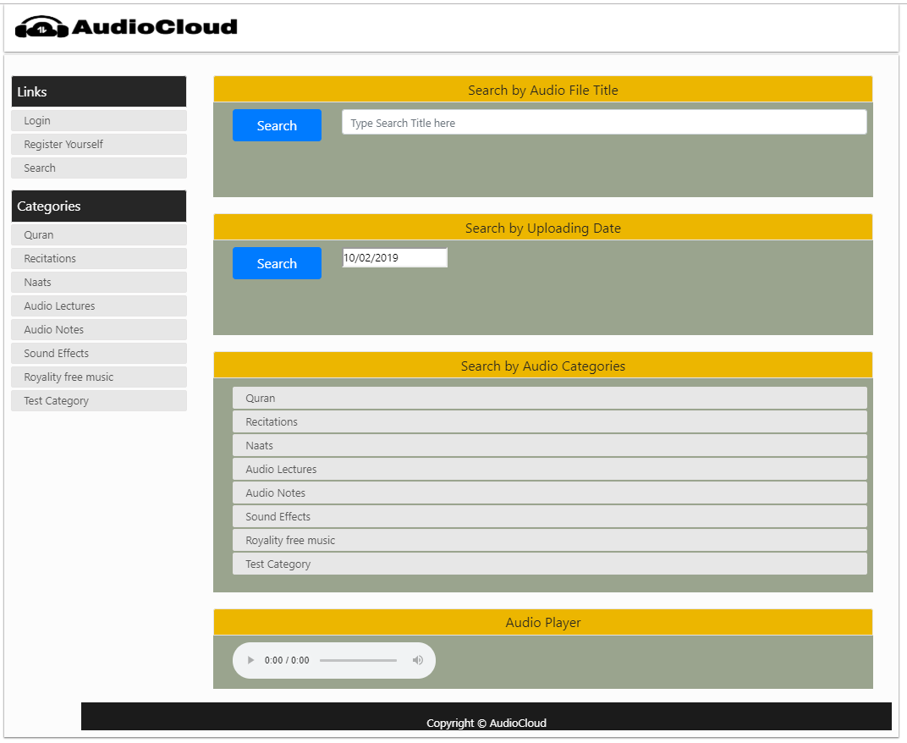
Search Home Page

Slide 32
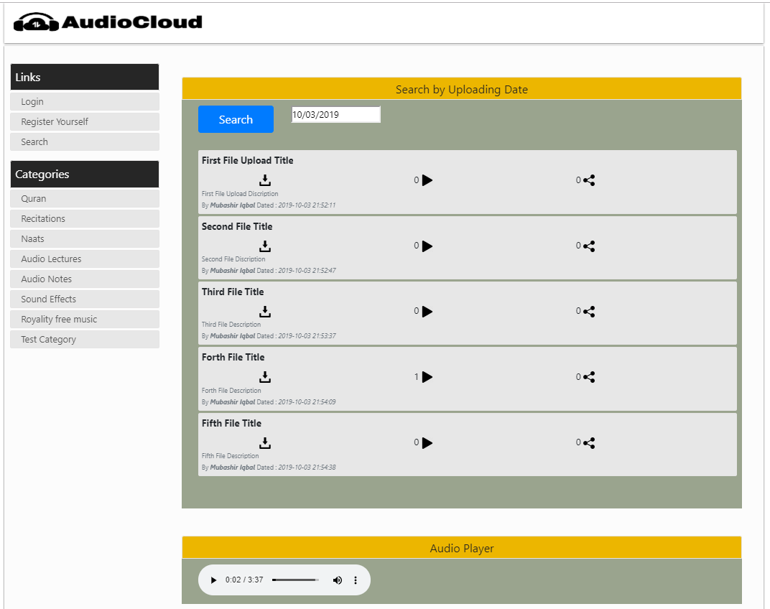
Search by Date Results Page

Slide 33
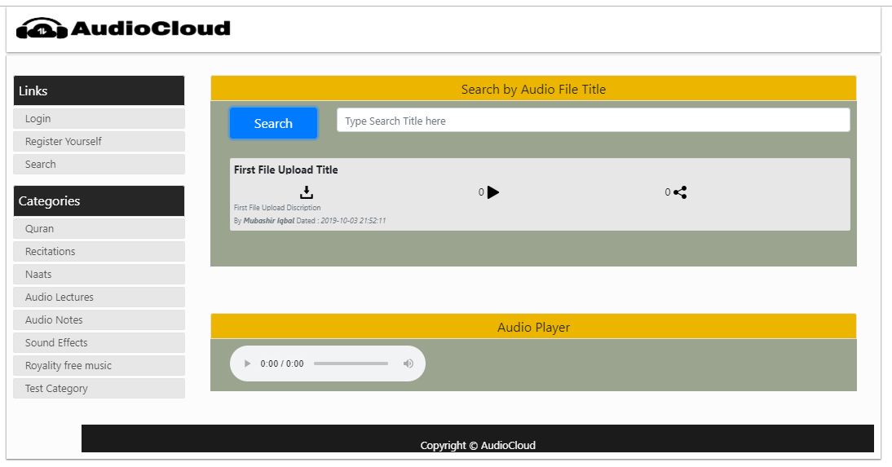
Search by Title Results page

Slide 34
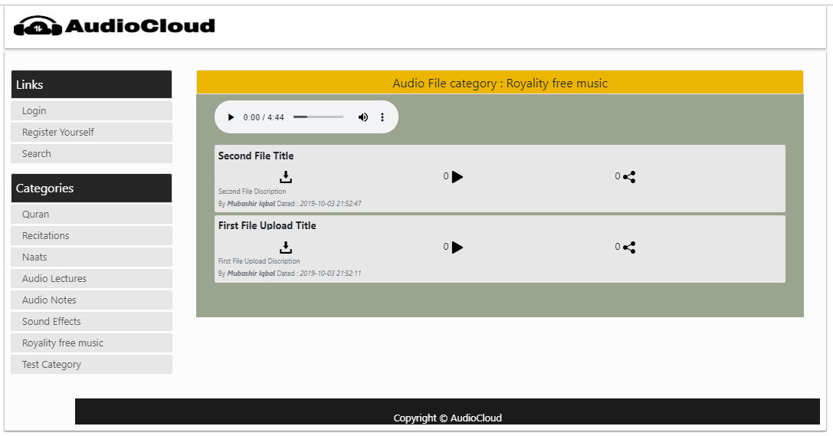
Search by Category Result Page

Slide 35
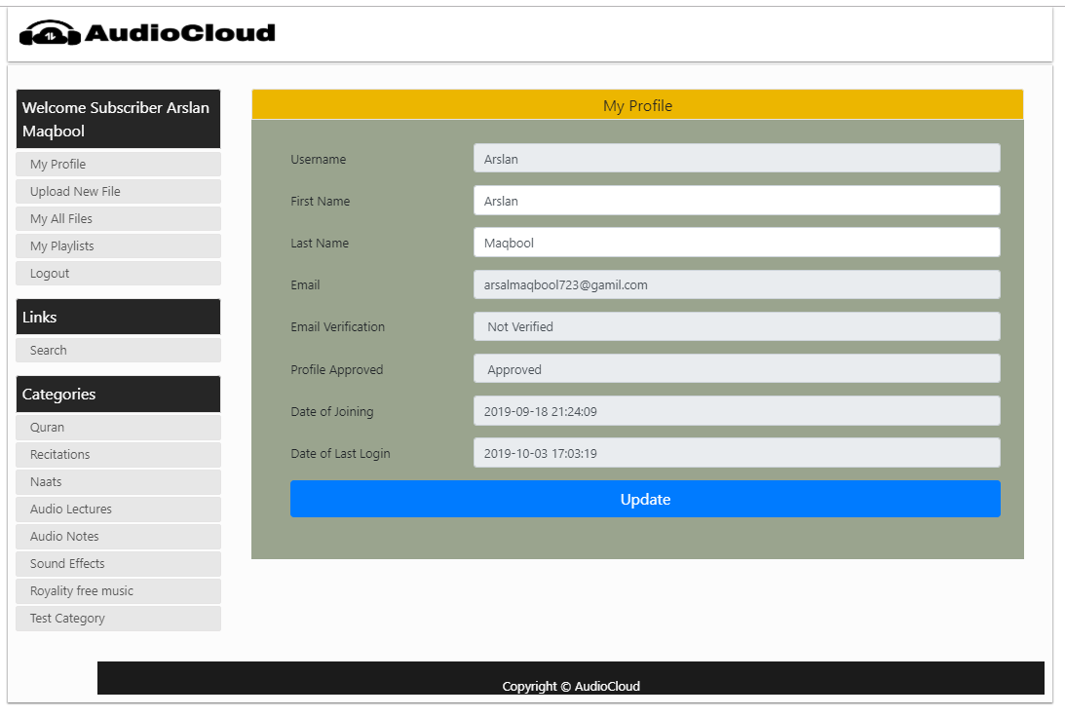
User Profile Page

Slide 36
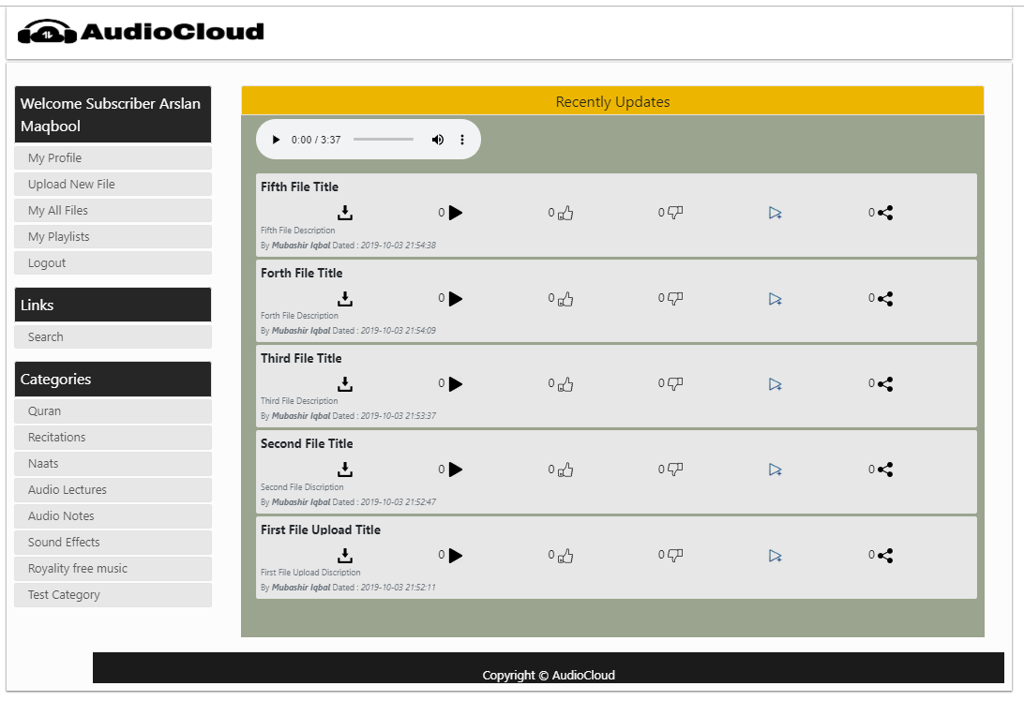
User Home Page

Slide 37
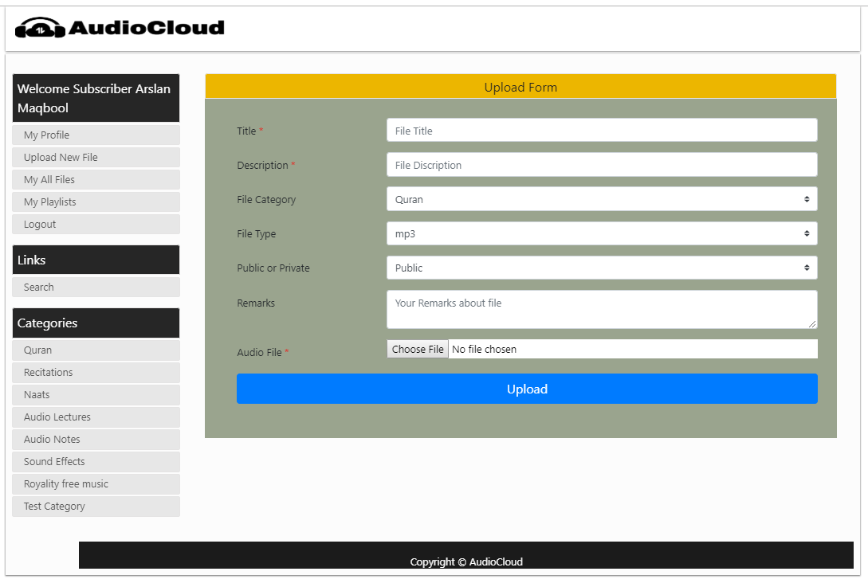
User Uploading New File

Slide 38
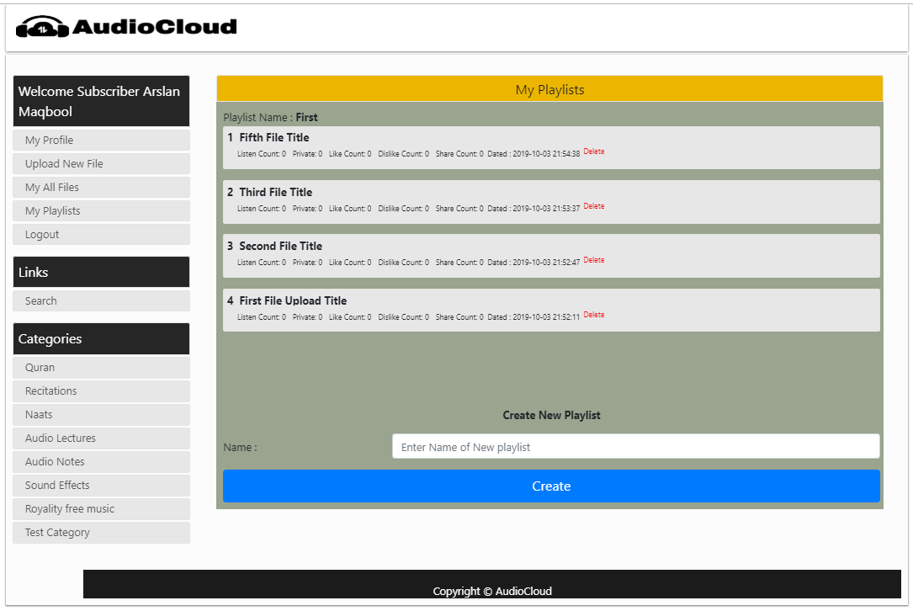
User Playlists Page

Slide 39
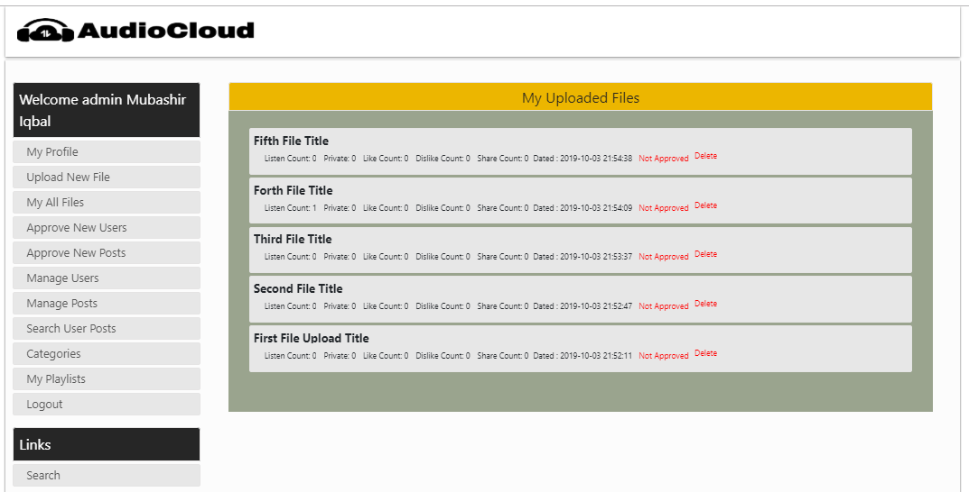
My All Uploads Page

Slide 40
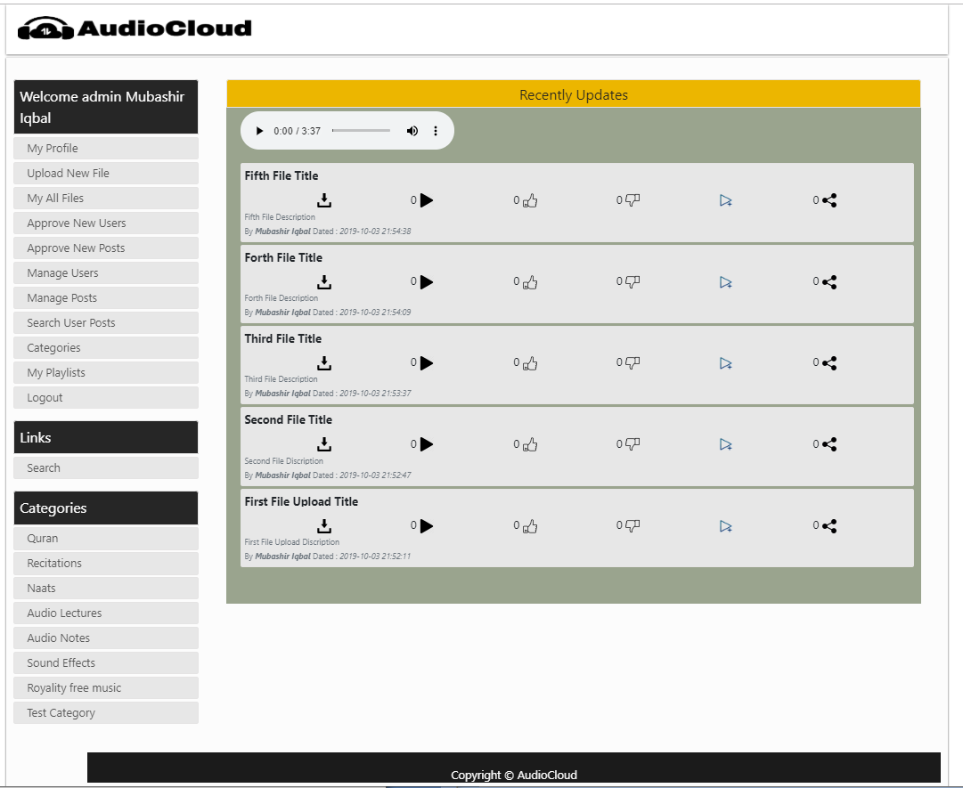
Admin Home Page

Slide 41
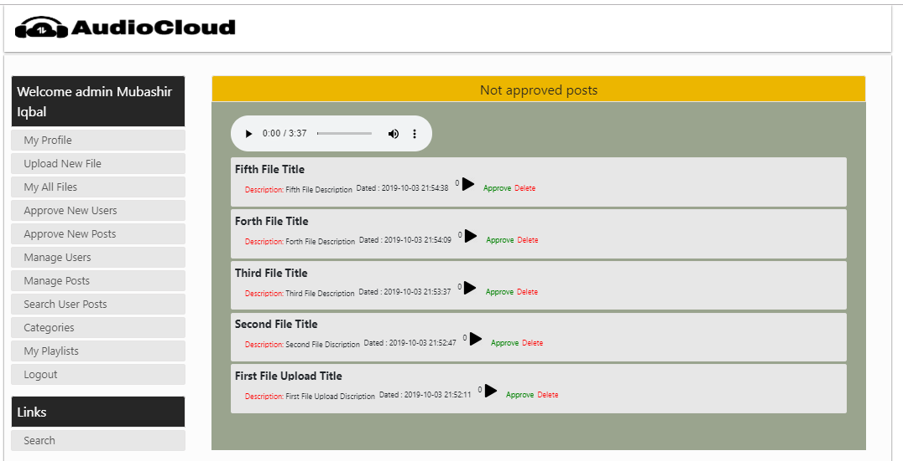
Post Approval Page

Slide 42
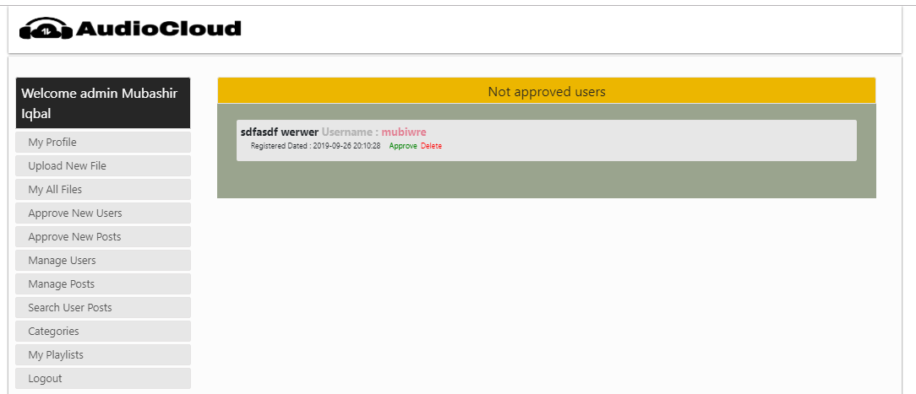
User Approval Page

Slide 43
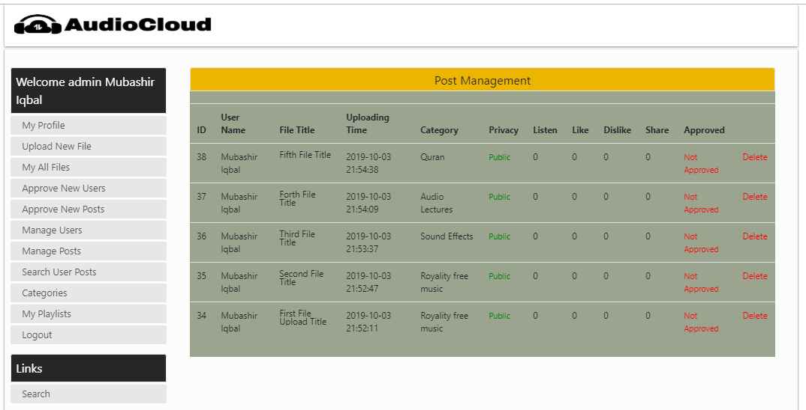
Post Management Page

Slide 44
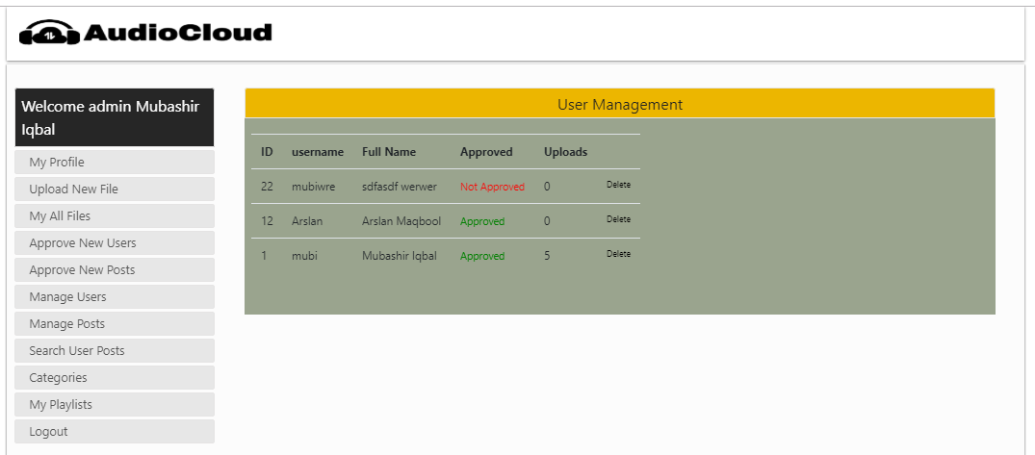
User Management Page

Slide 45
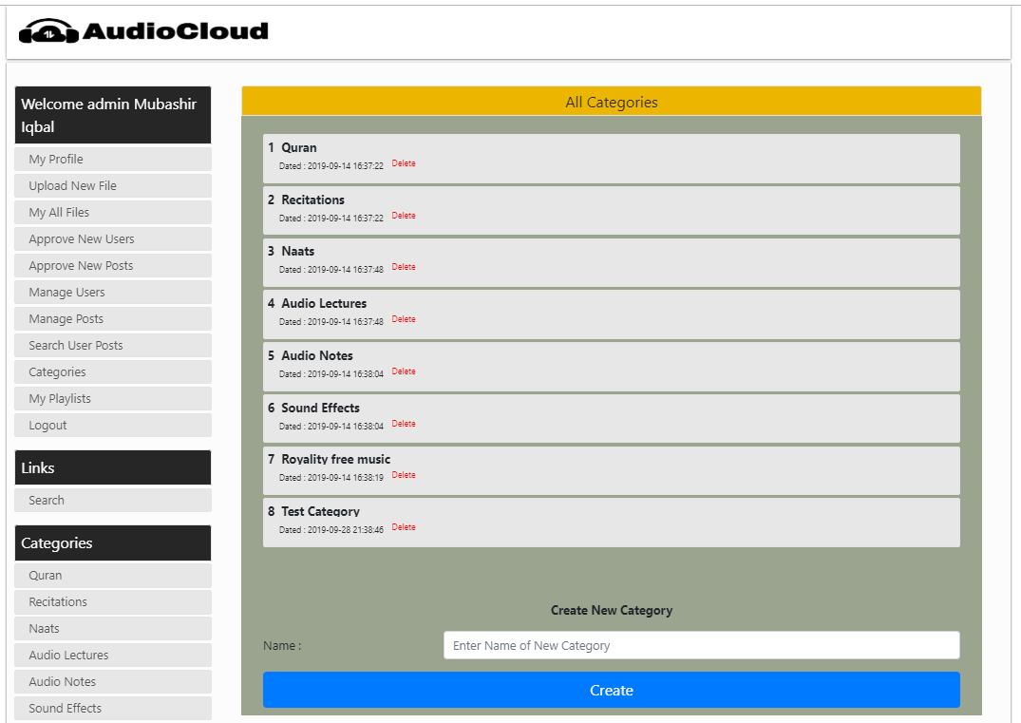
Adding, Deleting Category Page

Slide 46
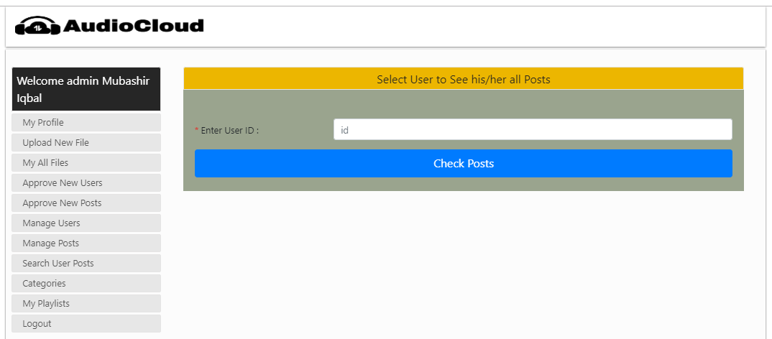
Search All Posts by UserID Page

Slide 47
Tools
Operating System : Window 10
Server Software : WampServer (3.1.9)
Database Server : mySQL (5.7.26)
Programing Languages
Frontend
HTML5
CSS3
JavaScript
Backend
PHP (Hypertext Preprocessor)

